Slide 1
Automatic Speech Recognition
Project Supervisor : Dr. Anil Kumar Vuppala
Project Mentor: Ganesh S Mirishkar
Group 1 Team Members :
Vijay Bhasker Kodam
Varsha Loya Ravathkar
Pravalika Kommagouni
Myla Mahojjwal
Varma MRKS

Slide 2
Agenda
INTRODUCTION 3
PROJECT OVERVIEW 4
DATABASE STATISTICS 5
MATHEMATICAL FORMULATION 6
METHODOLOGIES 7
STAGES & TIMELINES 8
INFERENCES 9
CHALLENGES 10
APPLICATIONS 11
REFERENCES 12

Slide 3
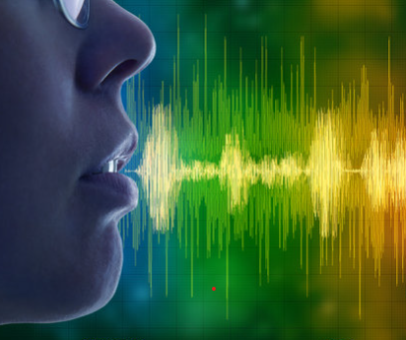
Introduction
Our Project focusses on a deployable model for Speech-text Conversion for Native Indian Language – Telugu
Automatic speech recognition is the capability of a computer system to decipher spoken words and phrases from audio and transcribe them into written text.
We choose the Kaldi toolkit for training the ASR using some hours of transcribed data.
We adopted HMM (Hidden Markov Model) and Deep learning models to achieve the Speech-To-Text functionality.

Slide 4
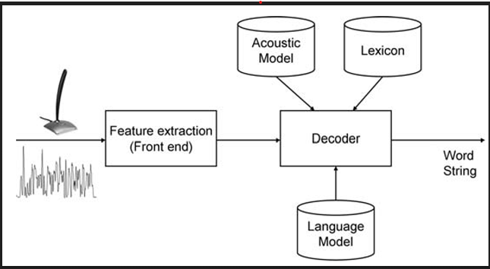
Project Overview
Developing a deep learning-based ASR model to improve accuracy and performance in transcribing speech in a variety of contexts and accents involves several steps. Here are some key considerations:
Data collection and pre-processing: Collecting a large and diverse dataset of speech samples is crucial for training an effective ASR model. This dataset should include samples from various accents, languages, and speech contexts. The speech samples should also be pre-processed to remove any noise or background sounds that could interfere with transcription accuracy.
Feature extraction: Once the data is collected and pre-processed, the next step is to extract features from the speech samples. This involves converting the raw audio signals into a series of numerical values that can be processed by the deep learning model. Common feature extraction techniques include Mel-Frequency Cepstral Coefficients (MFCCs) and Linear Predictive Coding (LPC).
Model architecture: Choosing an appropriate deep learning architecture is critical for the success of the ASR model. Recurrent Neural Networks (RNNs), Convolutional Neural Networks (CNNs), and Transformer-based models are all commonly used for speech recognition tasks. The architecture should be designed to handle variability in accents, languages, and speech contexts.
Training and optimization: Once the model architecture is selected, it needs to be trained on the dataset of speech samples. The training process involves optimizing the model's parameters to minimize the difference between the predicted transcriptions and the actual transcriptions. This is typically done using gradient descent-based optimization algorithms, such as Adam or Stochastic Gradient Descent (SGD).
Evaluation: After the model is trained, it needs to be evaluated on a separate test dataset to measure its accuracy and performance. Common evaluation metrics include Word Error Rate (WER), Character Error Rate (CER), and Sentence Error Rate (SER). The model can be further refined and optimized based on the evaluation results.

Slide 5
Database Statistics
Group 1
Language Chosen : Telugu
Train Data Size : 53 hours
Test Data Size : 6 hours
Dev Data Size : 1 hour
Facts : Telugu is the 4th most spoken language in India, having many dialects.

Slide 6
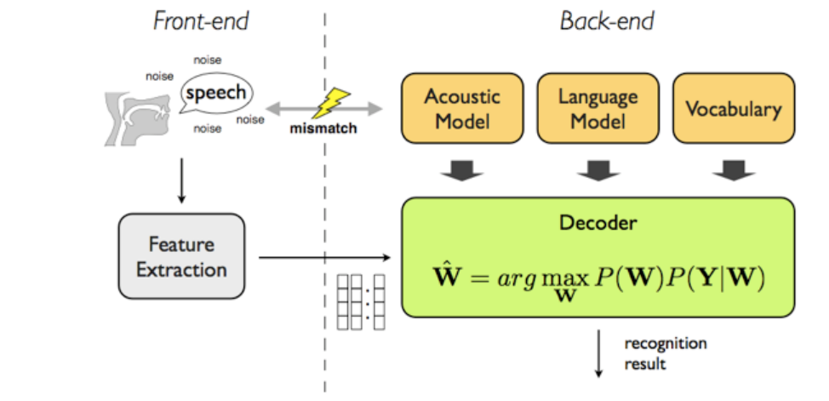
Mathematical Formulation
X denotes the feature vector derived from acoustic data and W denotes a string of words; therefore, the recognizer is capable of picking up the most preferred string.
P(W|X) denotes the probability that W are uttered given that X is detected.
The argmax function is referred to the most likely input that leads to maximum output.

Slide 7
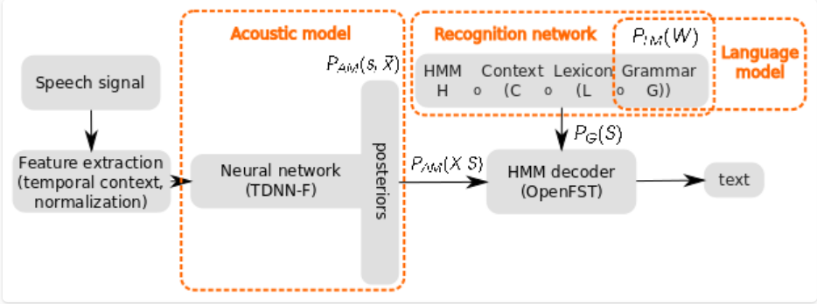
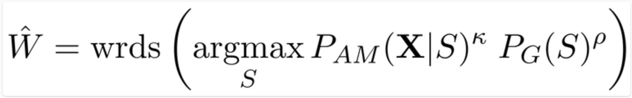
Methodologies
The central component is the HMM decoder, which explores the search space defined by the Recognition network H ◦ C ◦ L ◦ G.
Internally, the partial paths have costs computed from acoustic model scores Pam(X|S) and graph scores PG(S), where S is the hypothesized state-sequence of the partial path from the beginning of the utterance.
In the decoding formula (W) we see that we search for such state sequence S that has the maximal score, and we read the corresponding word sequence W’ by using the operator wrds(.). For optimal Word Error Rate (WER) performance, two hyper-parameters need to be identified, the acoustic scale κ and language-model scale ρ.

Slide 8
Timelines
Data Collection/Preparation
  Collect the Audio Files
  Pre-processing (Audio/Text)
Model Build/Test
  Feature Extraction
  Feature Normalization
  Build/Train the Model
  Test the Model with the Test Data
  Blind Test
Deployment
  FAST API
  WebSocket(TBD)
20th Nov – 27th Nov,2022
27th Nov,2022 – 7th Jan,2023
7th Jan – 11th Feb,2023

Slide 9
Inferences
30 instances recorded and decoded, which included the following
  Male and female voice
  Child voice
  Sentences with foreign languages
  Recordings from database
Content inferred
No. of Words(encounter-ed in the lexicon)
Consequence
Improvements
493311 words encountered
95% times correctly decoded ignoring few spell correction
Decoding error for rapid speech(fast talking) or lack of clarity
Limited time for encoding( =15 secs)
More training and updating the Lexicon with more words
Re-training for foreign languages and dialects
Good pauses between words increases accuracy
Generic statement
By improving efficiency, accuracy, accessibility, and user experience, ASR technology is transforming the way we interact with technology and each other.

Slide 10
Challenges
Huge Data Collection
Collecting a large and diverse dataset of speech samples is crucial for training an effective ASR model. This dataset should include samples from various accents, languages, and speech contexts. The speech samples should also be pre-processed to remove any noise or background sounds that could interfere with transcription accuracy.
Team Coordination
Team coordination is essential for achieving success in any collaborative endeavor. When team members are not effectively coordinating with each other, it can create loopholes that hinder progress and create inefficiencies. These loopholes can manifest in many ways, such as miscommunication, duplication of effort, lack of accountability, and poor decision-making.
No code background
while a lack of code background can create loopholes in software development projects, it is not an insurmountable obstacle. By leveraging the expertise of technical experts, using appropriate tools and platforms, and fostering open communication between team members, it is possible to mitigate the risks and achieve successful outcomes.

Slide 11
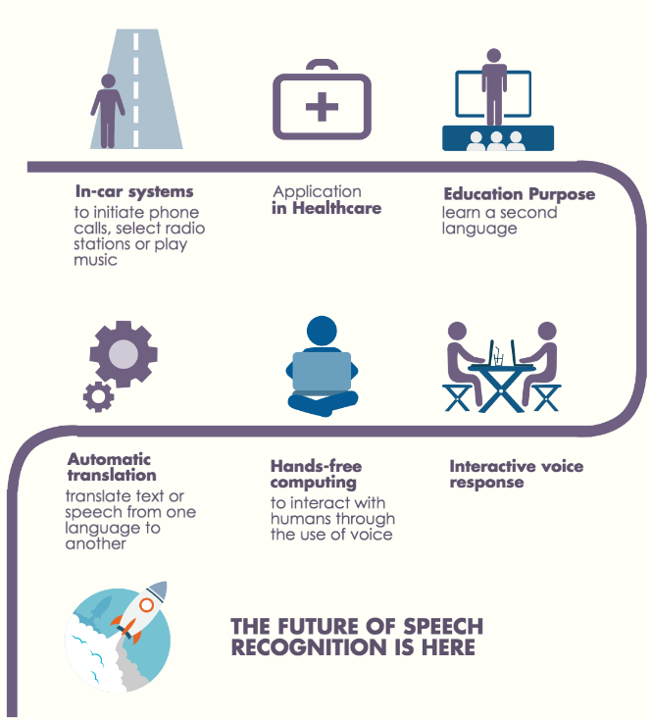
Applications
Virtual Assistants
Call Centres
Dictation Software
Transcription Services
Healthcare
Education
Gaming
Automotive

Slide 12

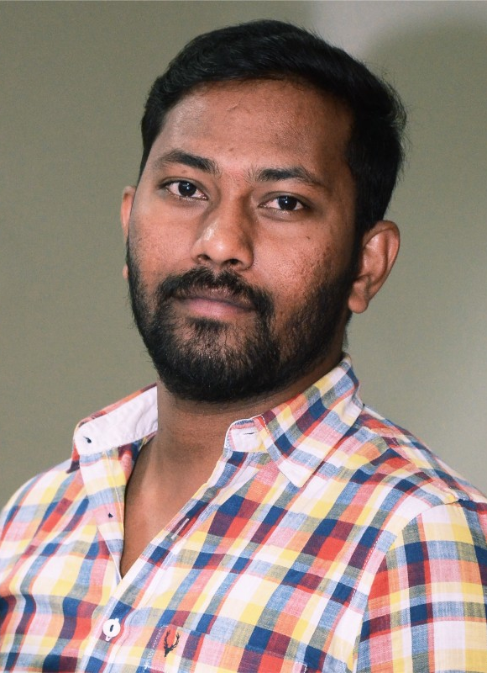

Meet our team
Ganesh
Vijay Bhasker
Varsha
Mentor
Team Member
Team Member

Slide 13
References
https://www.atco2.org/news/automatic-speech-recognition-how-it-works --> slide with methodologies
https://www.prnewswire.com/in/news-releases/speech-and-voice-recognition-market-to-rise-exponentially-at-a-cagr-of-19-8-cloud-based-segment-to-emerge-dominant-says-fortune-business-insights-828795577.html
https://www.esat.kuleuven.be/psi/spraak/theses/08-09-en/MDT.php
https://www.atco2.org/news/automatic-speech-recognition-how-it-works

Slide 14
Thank you

